Slide 1


César CEBALLOS-CASTANO
18/01/2024

Slide 2

Outline
Executive Summary
Introduction
Methodology
Results
Conclusion
Appendix

Slide 3
Executive Summary
In this capstone project, the main objective is to predict the successful landing of the SpaceX Falcon 9 first stage, with the ultimate goal of determining the cost of a launch. The approach involves leveraging various machine learning classification algorithms. The project follows a structured methodology, including phases such as Data Collection, Data Wrangling and Preprocessing, Exploratory Data Analysis, Data Visualization, and ultimately, Machine Learning Prediction.
Throughout the investigation, the analysis suggests that certain features related to rocket launches exhibit a correlation with the success or failure of these launches. The project employs different classification algorithms to make predictions. In the conclusion, it is highlighted that the Decision Tree algorithm appears to be the most suitable for addressing the specific problem of predicting the successful landing of the Falcon 9 first stage.

Slide 4
Introduction
In this capstone project, our primary objective is to forecast the successful landing of the Falcon 9 first stage. SpaceX takes pride in its groundbreaking approach of reusing the first stage of a rocket launch, a cost-saving strategy that sets them apart. The company prominently advertises on its website that its rocket launches cost a mere 62 million dollars, a stark contrast to competitors whose prices soar upwards of 165 million dollars. The crux of these savings lies in the remarkable reusability of the first stage.
The ability to predict whether the first stage will successfully land holds pivotal significance, as it directly influences the overall cost of a launch. This valuable information becomes a strategic tool, especially for companies considering bidding against SpaceX for a rocket launch contract. The central question guiding our investigation revolves around a set of features related to a Falcon 9 rocket launch: Will the first stage of the rocket land successfully? Unraveling the intricacies of this query through machine learning and data analysis stands at the forefront of our capstone project.

Slide 5

Section 1

Slide 6

Methodology
Executive Summary
Data collection methodology:
How data was collected
Perform data wrangling
How data was processed
Perform exploratory data analysis (EDA) using visualization and SQL
Perform interactive visual analytics using Folium and Plotly Dash
Perform predictive analysis using classification models
How to build, tune, evaluate classification models

Slide 7
Data Collection
API : spacex_url=« https://api.spacexdata.com/v4/launches/past »
Required the data from Space API
Clean the data
Web Page : https://en.wikipedia.org/wiki/List_of_Falcon\_9\_and_Falcon_Heavy_launches
Extract a Falcon 9 launch records HTML table from Wikipedia (using BeautifulSoup)
Parse the table and convert it into a Pandas data frame
Steps :
Request and parse the SpaceX launch data using the GET request
Normalize JSON response into a dataframe
Filter dataframe to only Falcon 9` launches and data wrangling
Handle missing values
Export to csv

Slide 8
Data Collection – SpaceX API
1
Getting Response from API
2
Converting Response to a .json file
3
Filter dataframe and export to flat file (.csv)
4
5
Apply custom functions to clean data
Assign list to dictionary then dataframe
Data Collection

Slide 9
Data Collection - Scraping
1
Getting Response from HTML
2
Creating BeautifulSoup Object
3
Creation of dictionary
4
5
Finding tables
Getting column names
8
6
Appending data to keys
7
Converting dictionary to dataframe
Dataframe to .CSV
Data Collection Scraping

Slide 10
Data Wrangling
1. Calculate the number of launches on each site
2. Calculate the number and occurrence of each orbit
3. Calculate the number and occurence of mission outcome per orbit type
4. Create a landing outcome label from Outcome column using one-hot encoding
5. Export to CSV
Data Wrangling

Slide 11



EDA with Data Visualization
The relationship between :
Scatter Plot
Flight Number and Launch Site
Flight Number and Orbit type
Payload and Orbit type
Payload and Launch Site
Bar Plot
Success rate of each orbit type
Line Chart
The launch success yearly trend
Scatter plots are employed to depict the correlation between two variables, essentially showcasing how changes in one variable correspond to changes in another. Scatter plots allow for a comprehensive representation of the data set and aiding in the identification of patterns or trends in the relationship between the variables being analyzed.
Bar diagrams are powerful tools for visually comparing data across diverse groups, utilizing categories and discrete values on respective axes to depict relationships. Primarily designed for quick comprehension of group comparisons, these versatile bar charts can effectively illustrate significant data changes over time, providing valuable insights into relationships and trends within datasets.
Line graphs are valuable for presenting data variables and trends with clarity, enabling predictions about outcomes not yet recorded based on the observed patterns.
Data Visualization

Slide 12

EDA with SQL
Displaying the names of the unique launch sites in the space mission
Displaying 5 records where launch sites begin with the string 'KSC’
Displaying the total payload mass carried by boosters launched by NASA (CRS)
Displaying average payload mass carried by booster version F9 v1.1
Listing the date where the successful landing outcome in drone ship was achieved.
Listing the names of the boosters which have success in ground pad and have payload mass greater than 4000 but less than 6000
Listing the total number of successful and failure mission outcomes
Listing the names of the booster_versions which have carried the maximum payload mass.
Listing the records which will display the month names, successful landing_outcomesin ground pad ,booster versions, launch_sitefor the months in year 2017
Ranking the count of successful landing_outcomesbetween the date 2010-06-04 and 2017-03-20 in descending order.
SQL

Slide 13
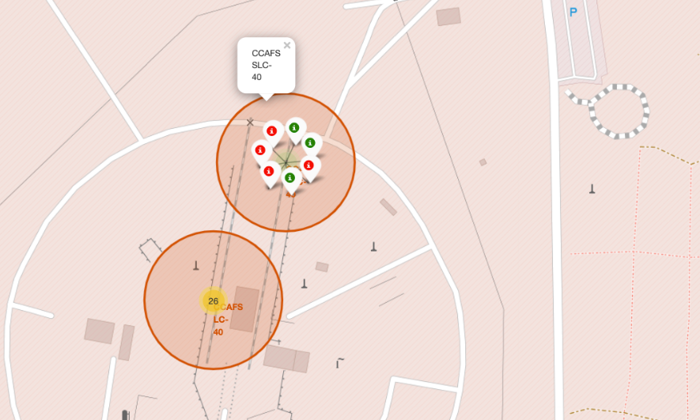
Build an Interactive Map with Folium
We made stuff and put it on a Folium map. Markers were used to show where all the launch sites are, and whether they were successful or not. Lines were drawn to figure out how far each launch site is from its nearby spots.
We assigned the dataframe launch_outcomes (failures, successes) to classes 0 and 1 with Green and Red markers on the map in a MarkerCluster()
Mark all launch sites on a map
Mark the success/failed launches for each site on the map
Calculate the distances between a launch site to its proximities
Whether it is close to the coast
Whether it is close to the railway
Whether it is close to the highway
Whether it is close to the city
Interactive Map

Slide 14
Build a Dashboard with Plotly Dash
A Scatter Graph illustrates the correlation between Outcome and Payload Mass (Kg) for various Booster Versions. This method excels at showcasing non-linear patterns, providing a clear view of data range from minimum to maximum values. It ensures straightforward observation and reading of the relationship between the two variables.
A launch site drop-down input component
A success-pie-chart based on the selected site dropdown
A range slicer to select payload
A success-payload-scatter-chart scatter plot based on the selected site dropdown
Dashboard with Plotly Dash

Slide 15
Predictive Analysis (Classification)
Data wrangling
Data standarization
Split into traning and test Datasets
Predictive model evaluation
Predictive model selection
Load our dataset into NumPy and Pandas
Transform Data
Split our data into training and test data sets
Check how many test samples we have
Decide which type of machine learning algorithms we want to use
Set our parameters and algorithms to GridSearchCV
Fit our datasets into the GridSearchCVobjects and train our dataset.
Logistic regression
Support vector machine
Decision tree classifer
K-nearest neighnors
Predictive Analysis

Slide 16
Results
Exploratory data analysis results
Interactive analytics demo in screenshots
Predictive analysis results

Slide 17

Section 2

Slide 18
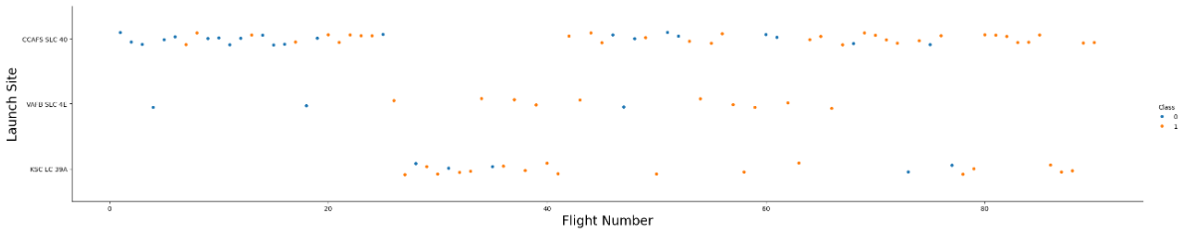
Flight Number vs. Launch Site
This figure shows that the success rate increased as the number of flights increased.
The blue dots represent the successful launches while the red dot represent unsuccessful luanches.
There seems to be an increase in successful flights after the 40th launch.

Slide 19
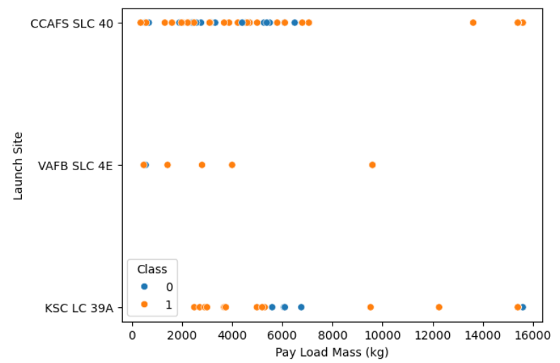
Payload vs. Launch Site
A higher payload mass at Launch Site CCAFS SLC 40 correlates with an increased success rate for the rocket. However, the visualization doesn't distinctly reveal a pattern to determine if the launch site is significantly dependent on payload mass for a successful launch decision.

Slide 20
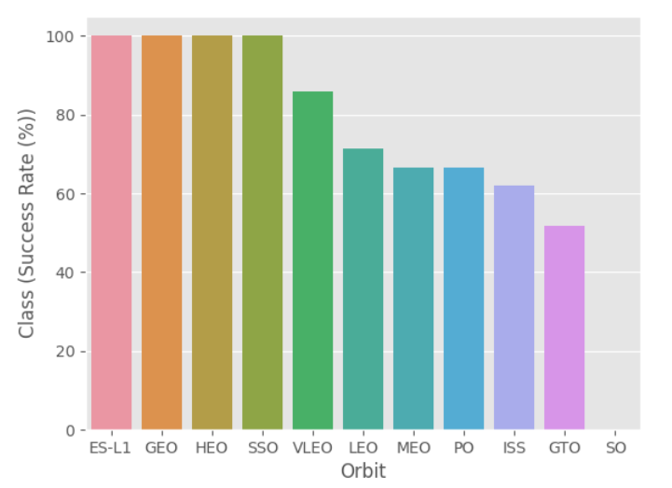
Success Rate vs. Orbit Type
Orbits ES-L1, GEO, HEO & SSO have the highest success rates at 100%, with SO orbit having the lowest success rate at ~50%. Orbit SO has 0% success rate.

Slide 21
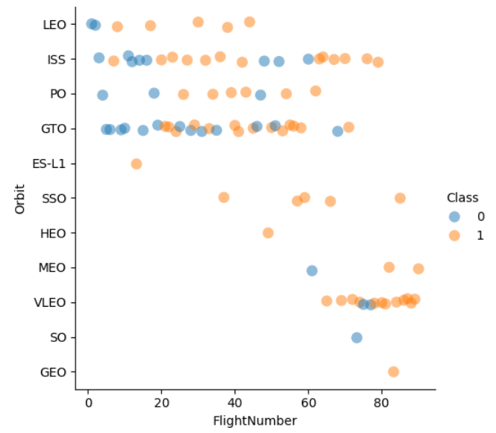
Flight Number vs. Orbit Type
In the LEO orbit, success seems linked to the number of flights, while in the GTO orbit, there appears to be no discernible relationship between success and flight number.

Slide 22
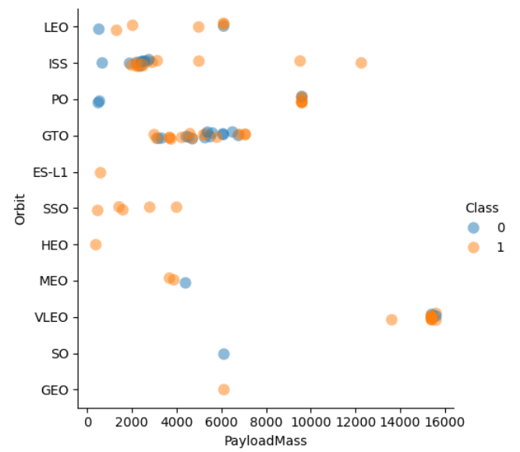
Payload vs. Orbit Type
Note that heavy payloads negatively impact GTO orbits but have a positive effect on GTO and Polar LEO (ISS) orbits.

Slide 23
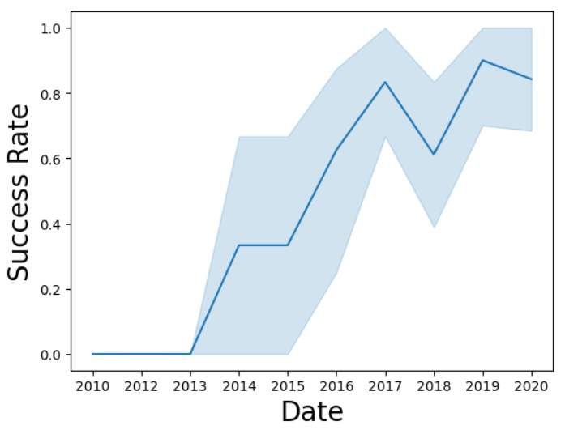
Launch Success Yearly Trend
We can observe that the sucess rate since 2013 kept increasing till 2020

Slide 24
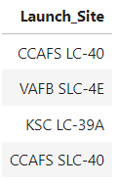
All Launch Site Names
SQL query : select Distinct(LAUNCH_SITE) from tblSpaceX
Using the word DISTINCT in the query means that it will only show Unique values in the Launch_Site column from tblSpaceX

Slide 25
Launch Site Names Begin with 'CCA'
SQL query : SELECT * from SPACEXTBL where (LAUNCH_SITE) LIKE 'CCA%' LIMIT 5
Using the query, it will only show 5 records from tblSpaceX and LIKE keyword has a wild card with the words the percentage in the end suggests that the Launch_Site name must start with CCA.

Slide 26
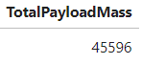
Total Payload Mass
SQL query : %sql select sum(PAYLOAD_MASS__KG_) as TotalPayloadMass from SPACEXTBL where Customer =='NASA (CRS)’
Using the function SUM summates the total in the column PAYLOAD_MASS_KG_. The WHERE clause filters the dataset to only perform calculations on Customer NASA (CRS)

Slide 27
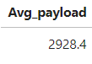
Average Payload Mass by F9 v1.1
SQL query : %sql select avg(PAYLOAD_MASS__KG_) as Avg_payload from SPACEXTBL where Booster_version Like 'F9 v1.1’;
Using the function AVG works out the average in the column PAYLOAD_MASS_KG_
The WHERE clause filters the dataset to only perform calculations on Booster_version F9 v1.1

Slide 28
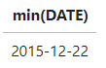
First Successful Ground Landing Date
SQL query : select min(DATE) from SPACEXTBL where Landing_Outcome = "Success (ground pad)";
Using the function MIN works out the minimum date in the column Date
The WHERE clause filters the dataset to only perform calculations on Landing_Outcome Success (ground pad)

Slide 29
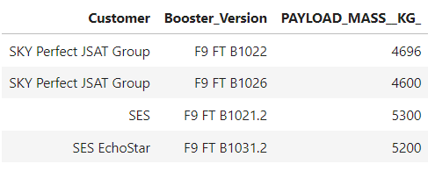
Successful Drone Ship Landing with Payload between 4000 and 6000
SQL query : select Customer, BOOSTER_VERSION from SPACEXTBL where LANDING_OUTCOME ='Success (drone ship)' and PAYLOAD_MASS__KG_ BETWEEN 4000 and 6000;
The WHERE clause filters the dataset to Landing_Outcome = Success (drone ship)
The AND clause specifies additional filter conditions
Payload_MASS_KG_>4000ANDPayload_MASS_KG_<6000

Slide 30
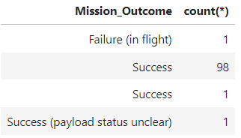
Total Number of Successful and Failure Mission Outcomes
SQL query : select MISSION_OUTCOME, count(*) from SPACEXTBL GROUP BY MISSION_OUTCOME;
There are 1 failure in flight, 99 successes and 1 success with unclear payload status.

Slide 31
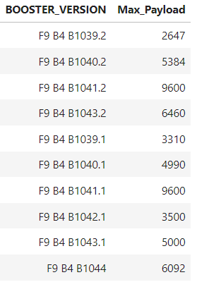
Boosters Carried Maximum Payload
SQL query : select BOOSTER_VERSION, Max_Payload from (Select BOOSTER_VERSION, MAX(PAYLOAD_MASS__KG_) as Max_Payload from SPACEXTBL Group BY BOOSTER_VERSION);
Different booster version has different max payload mass.

Slide 32
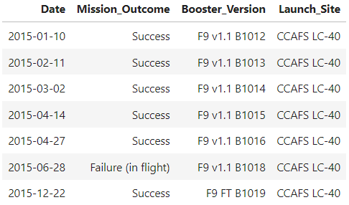
2015 Launch Records
SQL query : SELECT DATE,Mission_Outcome,Booster_Version,Launch_Site from SPACEXTBL where Date LIKE '%2015%’;

Slide 33
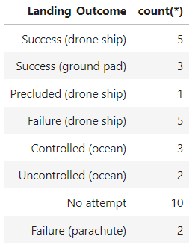
Rank Landing Outcomes Between 2010-06-04 and 2017-03-20
SQL query : SELECT LANDING_OUTCOME, count(*) FROM SPACEXTBL WHERE DATE BETWEEN '2010-06-04' AND '2017-03-20' Group by LANDING_OUTCOME ORDER BY DATE DESC;
Function COUNT counts records in column WHERE filtres data LIKE (wildcard) AND (conditions)AND (conditions)

Slide 34

Section 3

Slide 35
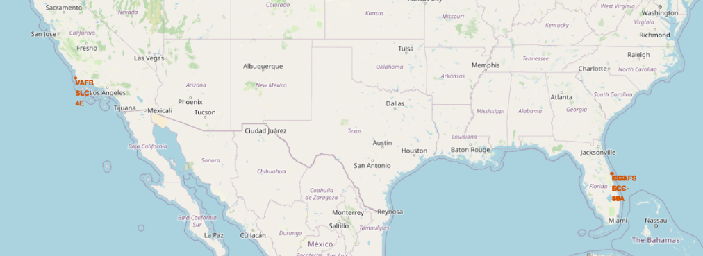
All launch sites global map markers
We can see that the SpaceX launch sites are in the United States of America coasts, Florida and California

Slide 36
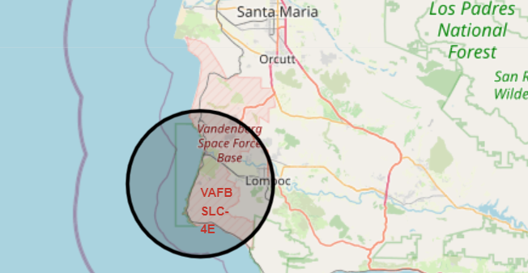
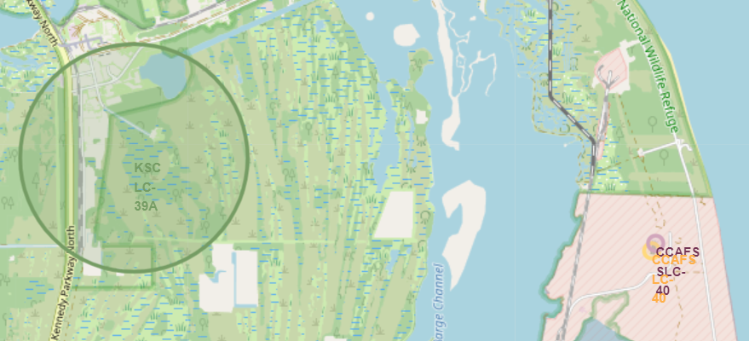
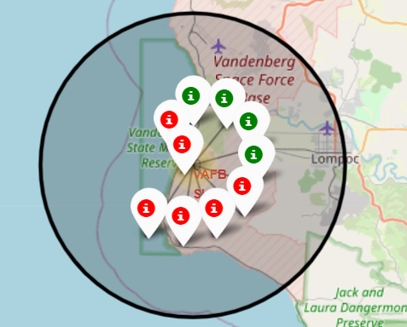
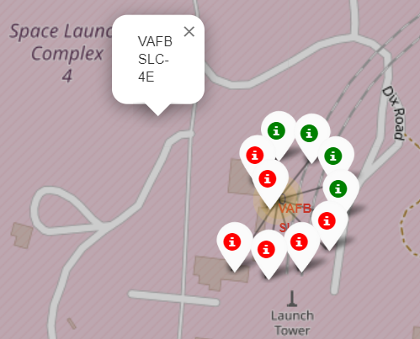
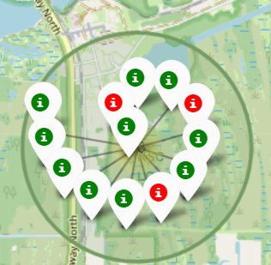
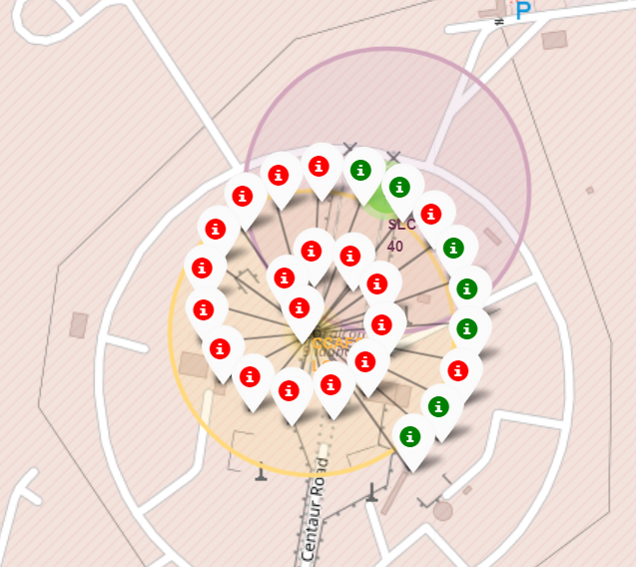
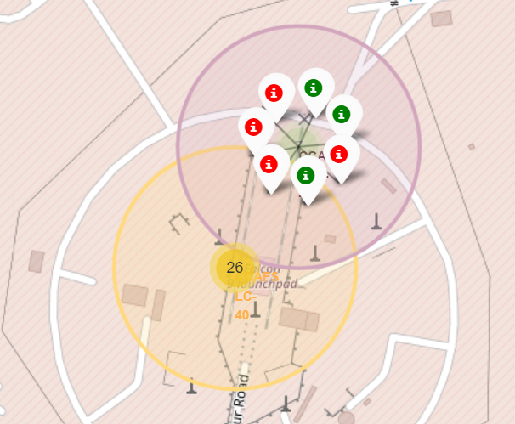
Colour Labelled Markers
California Launch Site
Florida Launch Sites
Green Marker shows successful Launches andRed Markershows Failures

Slide 37
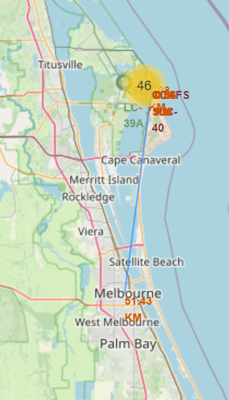
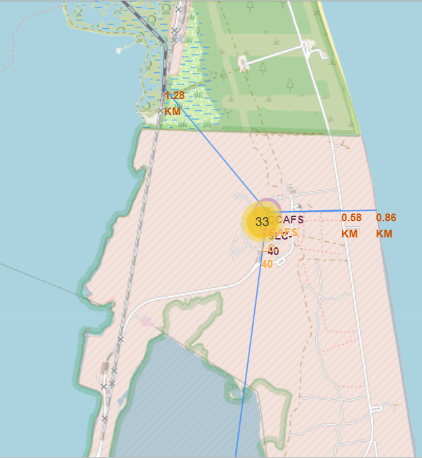
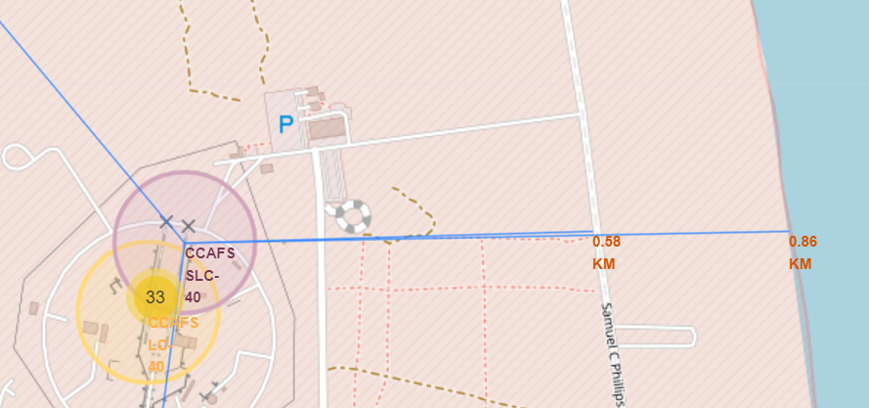
The proximity of the launch sites
CCAFS LC-40 is :
0.58 km from the Street “Samuel C Phillips”,
0.86 km from the coast
1.28 km from the railway
51.43 km from Melbourne

Slide 38

Section 4

Slide 39
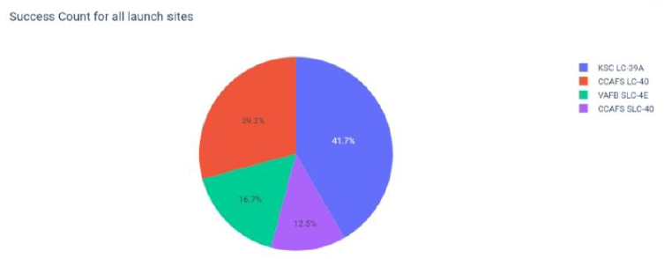
The Success Percentage Achieved by Each Launch Site
KSC LC 39A: 41.7%
CCAFS LC 40: 29.2%
VAFB SLC 4E: 16.7%
CCAFS SLC 40: 12.5%

Slide 40
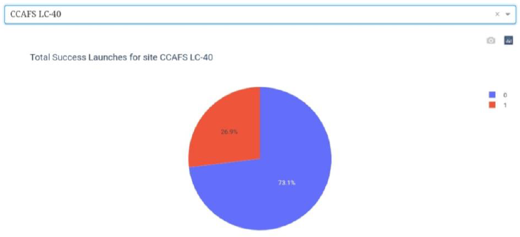
Launch site with highest launch success ratio
KSC LC 39A achieved a 76.9% success rate while getting a 23.1% failure rate

Slide 41
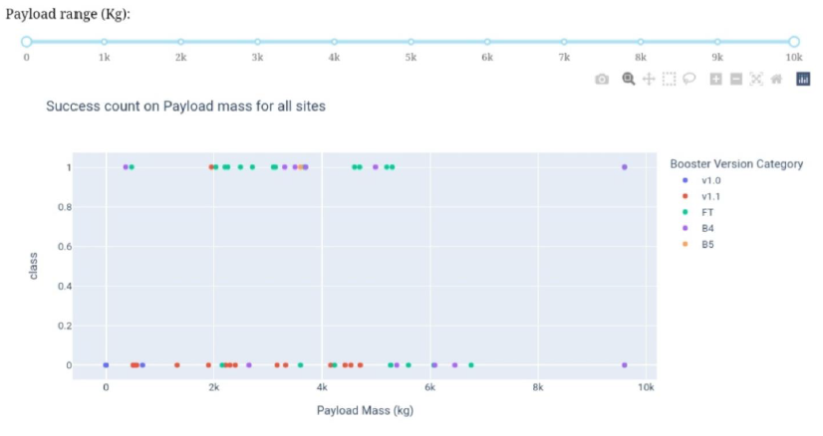
Payload vs Launch Outcome

Slide 42

Section 5

Slide 43
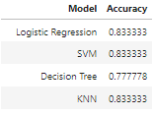
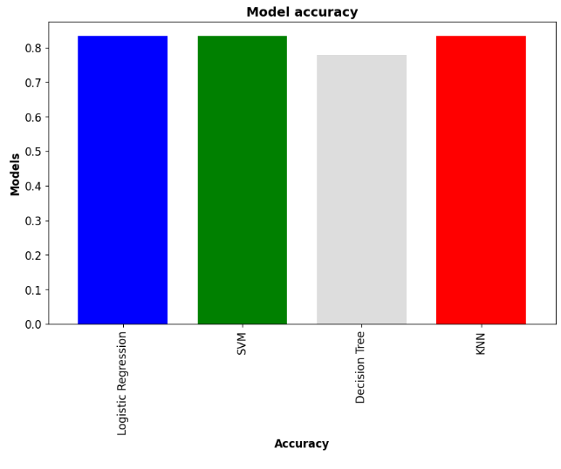
Classification Accuracy
After obtaining the accuracy of our various models, for the decision tree classifier using the validation data, we achieved 78% accuracy on the test data.

Slide 44
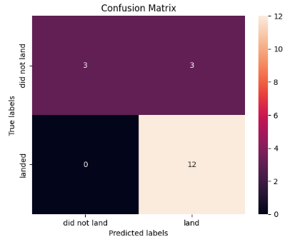
Confusion Matrix for Decision Tree
Examining the confusion matrix, we see that Tree can distinguish between the different classes.
The predictive model tells us that there will be 3 true positive, 12 true negative, 0 false positive and 3 false negative .

Slide 45
Conclusions
Launch site choice significantly influences success rates, and there is a correlation between payload mass and success, with heavier payloads decreasing the likelihood of the first stage's return.
Specific orbit types, such as ES-L1, GEO, HEO, and SSO, exhibit the highest success rates, contrasting with SO, which has the least success.
The overall success rate has witnessed a consistent increase since 2013, reaching its peak in 2020, indicating a positive trend over the years.
Utilizing the decision tree classifier with optimal parameters yielded the highest prediction accuracy at 78%, establishing it as the most effective algorithm for this dataset.
The performance of low-weighted payloads surpasses that of heavier payloads, suggesting a noteworthy impact on success rates based on payload mass.

Slide 46
Appendix
https://github.com/CesarCeballos0126/Space-X-Falcon-9-First-Stage-Landing-Prediction

Slide 47


